Slide 2
Auditing Azure SQL Database with Log Analytics
How, where and what
Notes:
opening screen
Metrics in WWI
Dashboard
Server
Monitor
Watcher

Slide 3


David Postlethwaite
SQL and Oracle DBA, Azure Powe BI Admin.
MCSE 2014 Data Platform
Oracle OCA
25+ years IT Experience
15+ years as DBA
E-MAIL
david@clunyweb.co.uk
LINKEDIN
www.linkedin.com/in/davidpostlethwaite
bankingcircle.com/careers
Notes:
Welcome
Good morning.
My name is David Postlethwaite, I work for Banking Circle, a financial services company based in Copenhagen and in Luxemburg
I have been working as both a SQL Server and Oracle DBA for well over 15 years
In my current role as well as DBA work I am also Azure Administrator , Power BI admin, automation, PowerShell and anything else my company needs to me to do.
And now I have become an accidental Fabric admin
Previous to being a DBA I was a developer using .NET, SQL, Access, FoxPro and Oracle
And way back in time I was a Windows and NetWare administrator.

Slide 4
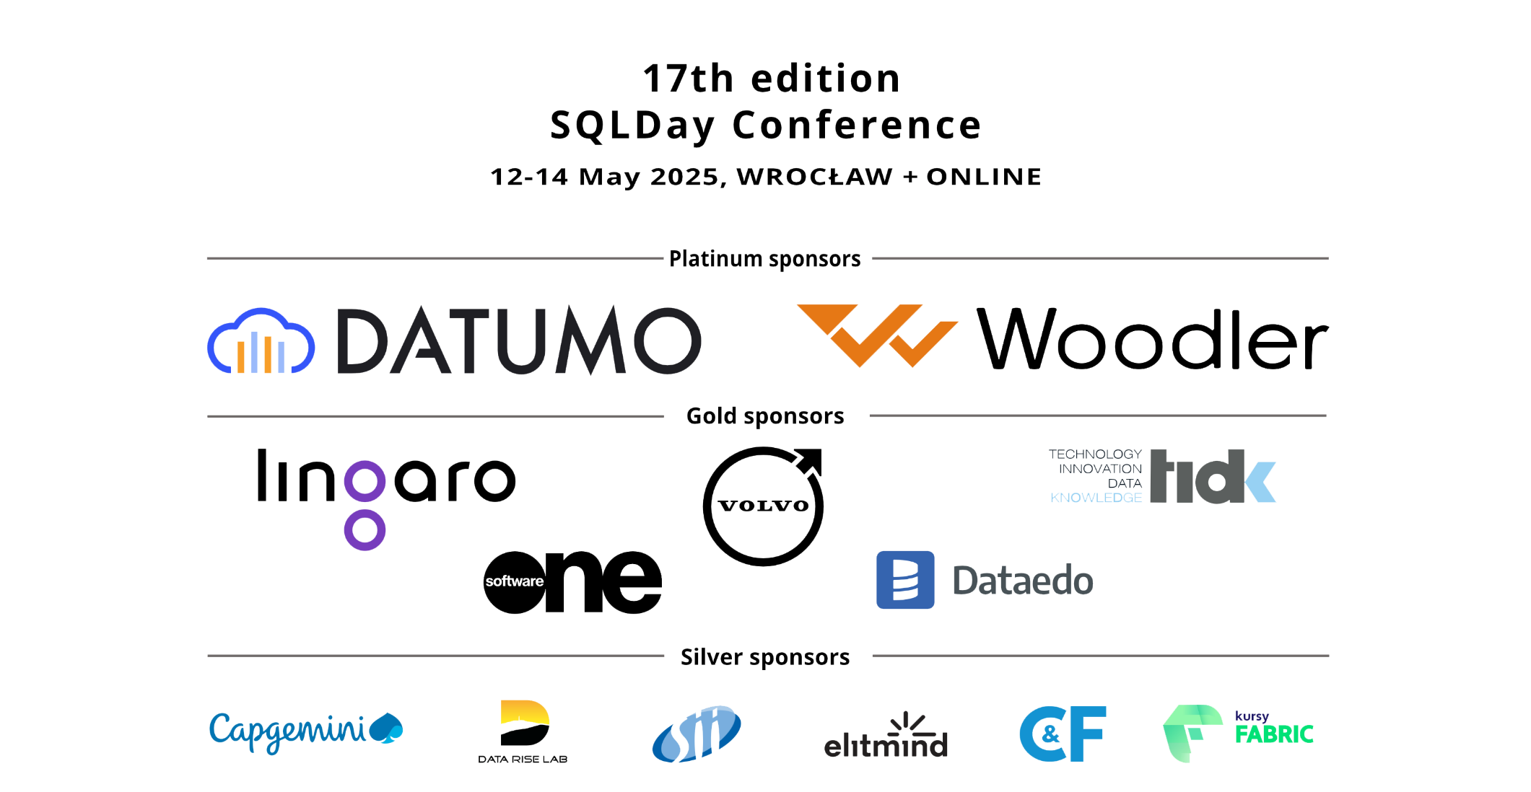

Slide 5
Agenda
Auditing - What we’ve lost in Azure SQL compared to SQL Server
What’s in Azure SQL by Default
Configure auditing in Azure SQL Database
Diagnostics options
Viewing the data in Azure Analytics
Introduction to the Kusto Query Language
Azure SQL Analytics to monitor performance (still in Preview after 4 years)
Azure SQL Security Insights
Azure Monitor (SQL was in Preview after 4 years – now removed)
Azure Workbooks
Database Watcher (guess what – it’s in preview)
Notes:
Here is what we plan to look at in the next hour
To start off
* We’ve moved from SQL Server on a VM to Azure SQL
What have we lost in terms of auditing and monitoring when we moved to Azure SQL Server?
* Now we are in Azure, what has Microsoft given us to monitor our databases
What we get by default, it’s been there since the beginning of Azure and you have probably already seen it
Then the hidden extras
* Auditing, logging and * diagnostics settings
* How we can view this data using Azure Log Analytics
* Which will lead us onto the Kusto Query Language. We’ll have a quick tour of KQL and the basics of writing queries in Kusto inside Log Analytics
Next , two features which aren’t so well known but pretty useful
* Azure SQL Analytics (still in Preview after 4 years)
* and Azure SQL Security Insights
* These were going to replaced by Azure Monitor, the SQL part which had been in preview for over 4 years. But it was removed last year
* Azure Monitor leads us to take a look at Azure Workbooks and what we can do with them to help with our monitoring.
* Finally, there is a “new” feature called Database Watcher which is what Microsoft says is the way forward for monitoring our Azure SQL databases.
And guess what? That ’s in preview as well
That’s a lot to cover so let see how we get on

Slide 6
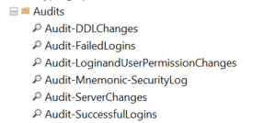
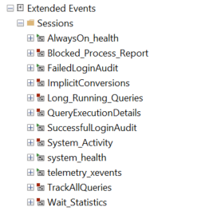
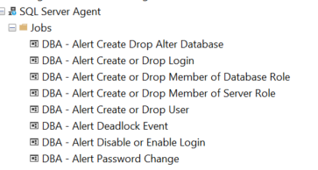
SQL VM
Audits
Extended Events
Agent alerts
Notes:
SQL VM –
We have
Audits,
Extended Events
SQL Agent Alerts
All these things helped us to get an idea what was going on and to get alerted about our SQL Server on a virtual machine, you may have other things and I expect you have all these configured on your VM
But in Azure SQL we don’t have these options
7 years ago I had a talk – “introduction to Azure” and people were quite shocked back then that these things were missing in Azure SQL
But we must remember that Azure SQL is just “Database as a service”, it is just somewhere to put our tables, views and procedures, Nothing more..
We’ve now got used to not having these features now so what do we do now ?

Slide 7
DEMO TIME
Notes:
1. WorldWide Importers – Metric and Alerts

Slide 8
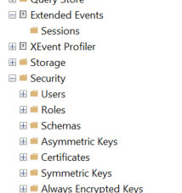
Basic Azure SQL
But we don’t have these on Azure SQL database,
limited extended events
Notes:
But we don’t have these on Azure SQL database, okay there are extended events but they aren’t se easy to setup and you can’t get real time output

Slide 9
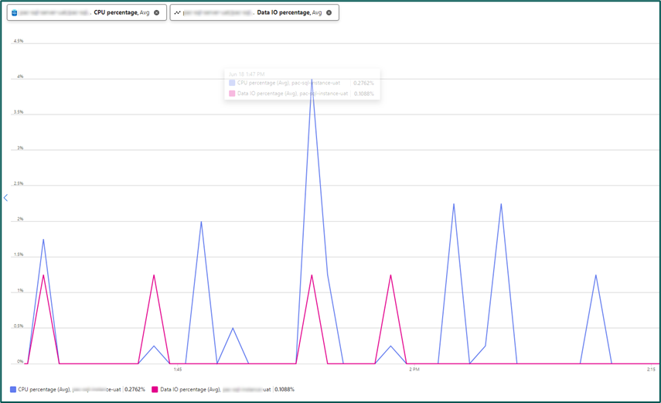
Metrics
Notes:
Metrics
What do we get in Azure for monitoring in the portal ?
The most basic is under Monitoring/metrics where we can see some very basic stats on the database, cpu, disk space,
This data is stored somewhere inside Azure, doesn’t seem possible to get to the raw data

Slide 10
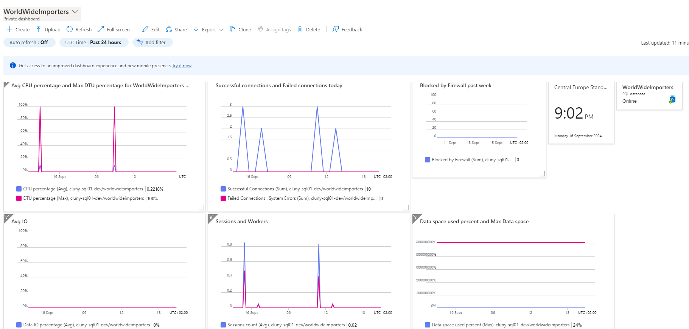
Dashboards
Notes:
Dashboards
We can create dashboards to display and share our performance metrics. Dashboards have been here since the outset of Azure
Are pretty easy to create

Slide 11
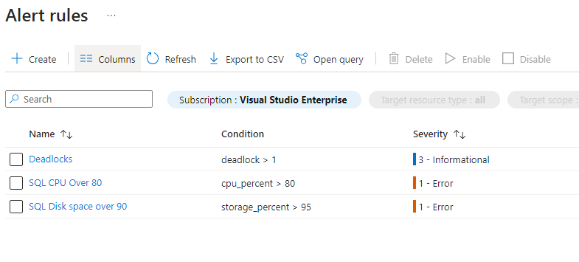
Alerts
Notes:
Alerts
We can also set up basic alerts based on those graphs, that can email or send SMS alerts to admins
Again this has been around since the start of Azure
There are further conditions that can be configured in Alerts page of the portal

Slide 12
Pretty basic stuff
What else is there in Azure to monitor our database

Slide 13
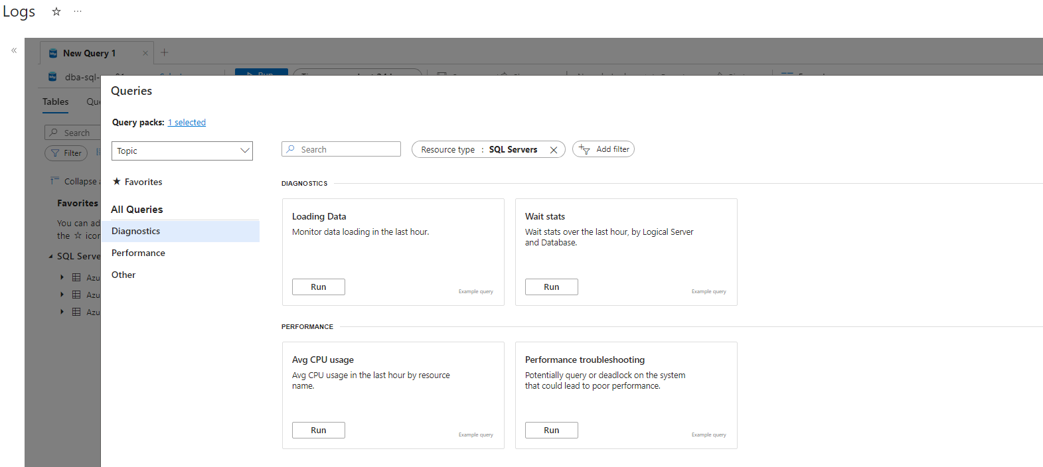
Logs
Notes:
Logs 1
That doesn’t give us much insight or detail into what’s going on our SQL database
At the bottom of the left hand menu we have “Logs”, where we can run queries against data that is collected regarding our database

Slide 14
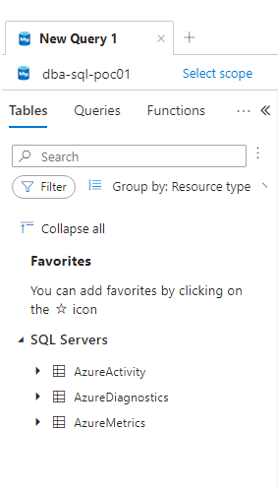
Logs
There are only three tables
AzureActivity
Entries from the Azure Activity log that provides insight into any subscription-level or management group level events that have occurred in Azure.
AzureDiagnostics
Stores resource logs for Azure services that use Azure Diagnostics mode. Resource logs describe the internal operation of Azure resources.
AzureMetrics
Metric data emitted by Azure services that measure their health and performance.
Notes:
Logs 2
We only have three tables
AzureActivity
Entries from the Azure Activity log that provides insight into any subscription-level or management group level events that have occurred in Azure.
AzureDiagnostics
Stores resource logs for Azure services that use Azure Diagnostics mode. Resource logs describe the internal operation of Azure resources.
AzureMetrics
Metric data emitted by Azure services that measure their health and performance.
By default only AzureActivity has any data in it
Fun part. You can query these even if you haven’t configured auditing to log analytics.
Diagnostics and metrics It won’t return any data and it won’t give an error either
We need to enable auditing for the server
Server auditing will only return data activity on master , not any of the user databases (although it implies it does)

Slide 15
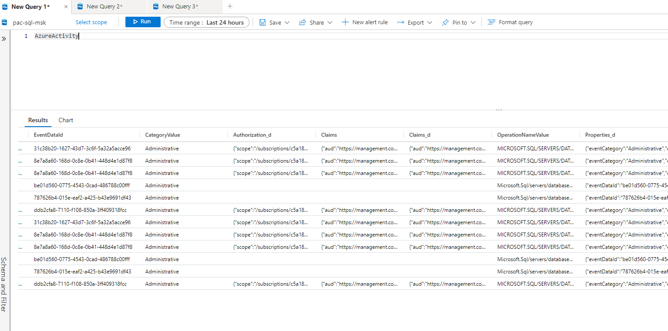
LOGS - azureactivity
By default only AzureActivity has any data in it
Notes:
Logs 3
By default only AzureActivity has any data in it

Slide 16
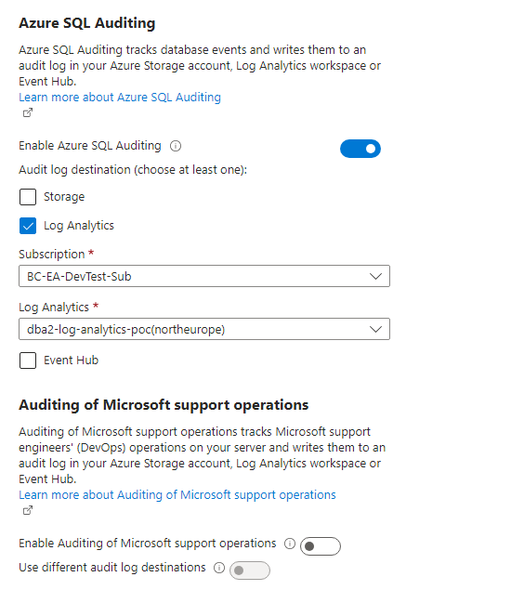
Auditing
We need to enable auditing for the server
Server auditing will only return data activity
on master , not any of the user databases
Notes:
Auditing
To gather more information, we need to enable auditing for the server
Server auditing will only return data activity on master , not any of the user databases (although it implies it does)

Slide 17
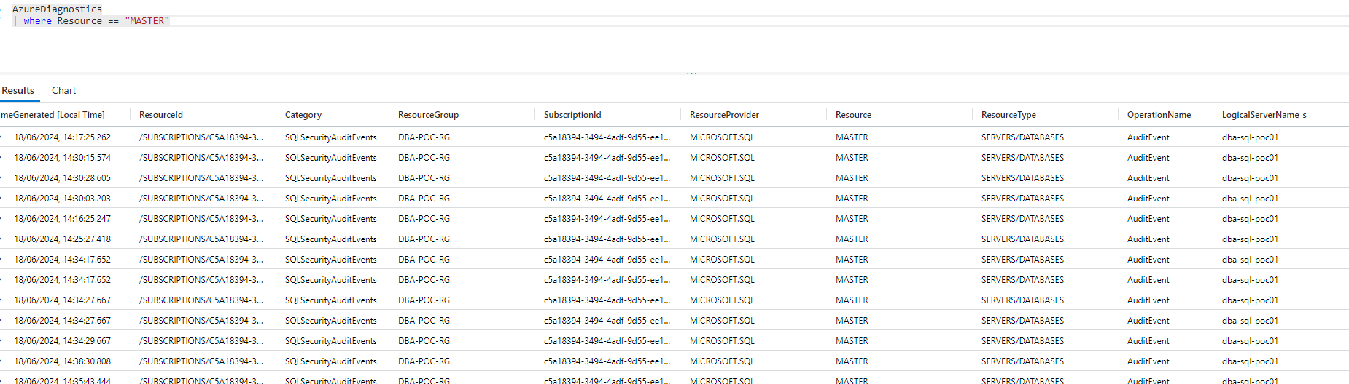
Audit
Server auditing will only return Diagnostic data activity on master , not any of the user databases
Notes:
Auditing
Server auditing will only return Diagnostic data activity on master , not any of the user databases

Slide 18
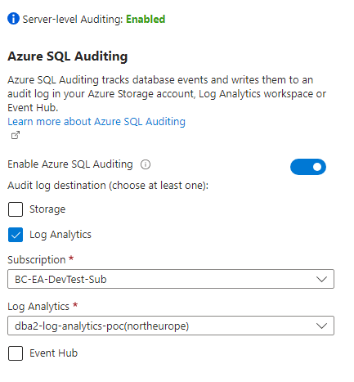
Database Auditing
As you have seen server auditing doesn’t give us much information
We have two further database auditing options
Database Audit to the same Log Analytics workspace
Watch out for this message. It is only for auditing written to blob , not for Log analytics
This option produces limited amount of data on the database activity
But importantly This option will enable recording activity on any read only replica that may be configured
It also enables the option “View Audit Logs” , more later
Notes:
As you have seen, server auditing doesn’t give us much information
We have two further database auditing options
Database Audit to the same Log Analytics workspace
Watch out for this message. It is only for auditing written to blob , not for Log analytics
This produces limited amount of data on the database activity
But importantly This option will enable recording activity on any read only replica that may be configured
It also enables the option “View Audit Logs” , more later

Slide 19
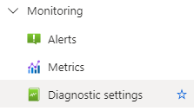
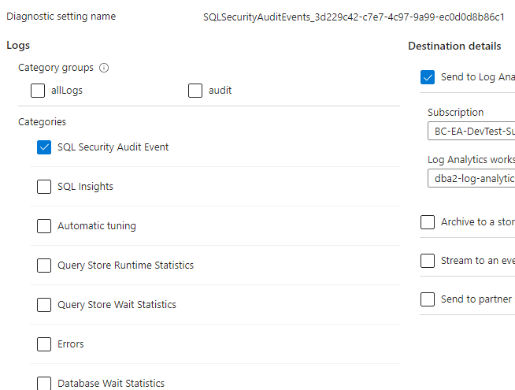
SQL Security Audit Event
The second part is Diagnostic Settings Turning on database Auditing
has created a diagnostic setting
called SQLSecurityAuditEvents_<GUID>
with just SQL Security Audit events captured
We really want to capture all diagnostic events
Notes:
Turning on database Auditing creates a diagnostic setting called SQLSecurityAuditEvents_<GUID> with just SQL Security Audit events captured
We really want to capture all diagnostic events

Slide 20
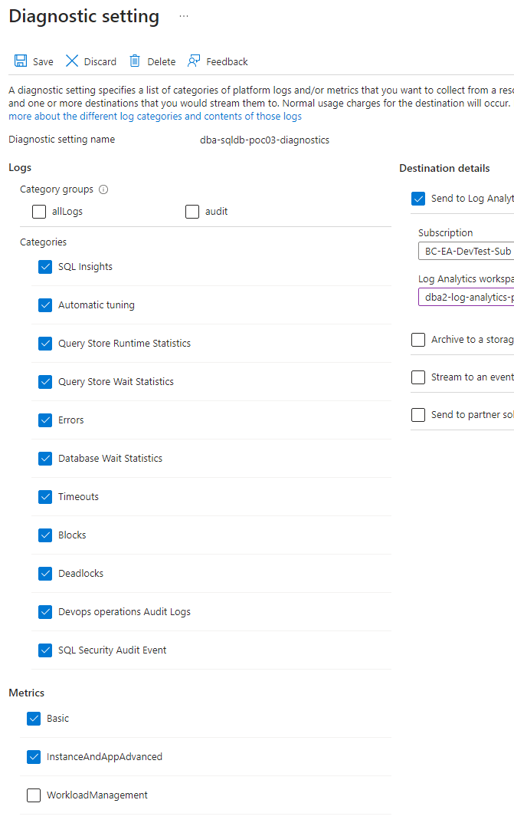
Diagnostic Settings
Here is the full list of events we can capture
And it is this that really gives the information we are after
Notes:
Here is the full list of events we can capture
And it is this that really gives the information we are after

Slide 21
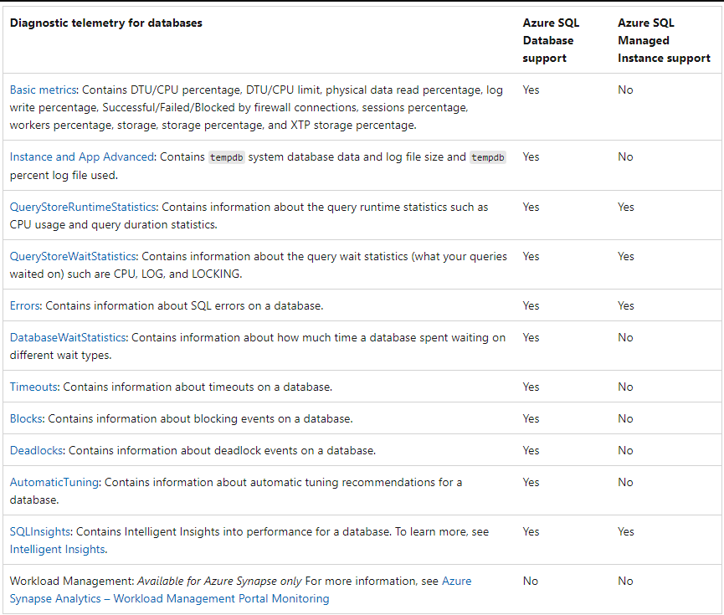
Diagnostic Options
Notes:
Explanation of Diagnostic Options
https://learn.microsoft.com/en-us/azure/azure-sql/database/metrics-diagnostic-telemetry-logging-streaming-export-configure?view=azuresql&tabs=azure-portal

Slide 22
What is collected
Server Audit | off
DB01 Audit | off
DB01 Diagnostics | on
DB02 Audit | on |  | db02
DB02 Diagnostics | on
DB03 Audit | on
DB03 Diagnostics | off
Server Audit | on
DB01 Audit | off | master
DB01 Diagnostics | on
DB02 Audit | on | master | db02
DB02 Diagnostics | on
DB03 Audit | on | master
DB03 Diagnostics | off
Notes:
Different combinations of server, database and diagnostic auditing can result in different data being collected
Having all three can result in duplication of data, database queries being recorded in the sever and database audit logs.
The duplicate will show the same query in the server log as running on master and again in the database log as running on the database

Slide 23
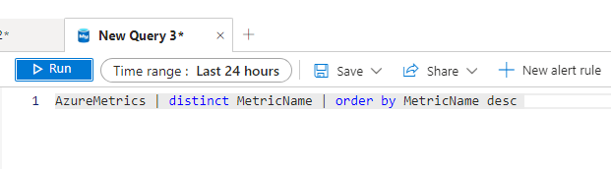
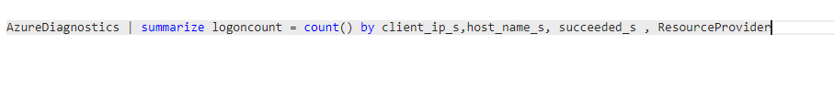
Kusto Query Language KQL
Notes:
Kusto Query Language
Now we have data let’s run some queries
Demonstrate
KQL Explanation
1. click on table name
AzureDiagnostics
this is like saying SELECT * FROM AzureDiagnostics WHERE 1=1
2. Add a where clause.
Note you need to add "|" like in PowerShell
but the equality is like in c#
AzureDiagnostics
| where Category == 'SQLSecurityAuditEvents'
this is like saying SELECT * FROM AzureDiagnostics WHERE Category = 'SQLSecurityAuditEvents'
3. We can add more where clauses
AzureDiagnostics
| where Category == 'SQLSecurityAuditEvents'
| where TimeGenerated > ago(24h)
OR
AzureDiagnostics
| where Category == 'SQLSecurityAuditEvents' and where TimeGenerated > ago(24h)
4. limit the columns returned
AzureDiagnostics
| where Category == 'SQLSecurityAuditEvents'
| where TimeGenerated > ago(24h)
| project
event_time_t,
statement_s,
succeeded_s,
affected_rows_d,
server_principal_name_s,
client_ip_s,
application_name_s,
additional_information_s,
data_sensitivity_information_s
5. order the data
| order by event_time_t desc
6. Limit the number of rows returned
| take 100
New query
let start = ago(24h);
let end = now();
let timeGrain=5m;
AzureMetrics
| where ResourceProvider == "MICROSOFT.SQL" and Resource != "MASTER"
| where TimeGenerated > start and TimeGenerated < end
| where MetricName == "cpu_percent"
AzureMetrics
| where ResourceProvider == "MICROSOFT.SQL" and Resource != "MASTER"
| where TimeGenerated > start and TimeGenerated < end
| where MetricName == "cpu_percent"
| summarize avg(Average) by Resource, bin(TimeGenerated, max_of(timeGrain, 1m))
| render timechart
New Query
find the top 5 max
AzureMetrics
| where ResourceProvider == "MICROSOFT.SQL" and Resource != "MASTER"
| where TimeGenerated > ago(4h)
| where MetricName == "cpu_percent"
| top 5 by Maximum
|project TimeGenerated,Maximum,Minimum
AzureMetrics
| distinct MetricName
AzureMetrics
| count
Tak / Thank you
David
David Postlethwaite
Database Administrator
+45 31 69 12 61
Lautrupsgade 15, 2150 Copenhagen Denmark bankingcircle.com
THE PAYMENTS BANK
FOR THE NEW ECONOMY
Banking Circle S.A. is a credit institution under the direct supervision of the Luxembourg Commission of the Financial Sector (www.cssf.lu) with registration number LUB00000408 and business registration number B222.310. For more information on Banking Circle and its branches please visit https://www.bankingcircle.com/regulatory-information This email may contain confidential and/or privileged information. If you are not the intended recipient (or have received this email by mistake), please notify the sender immediately and destroy this email. Any unauthorised copying, disclosure or distribution of the material in this email is strictly prohibited. Email transmission security and error-free status cannot be guaranteed as information could be intercepted, corrupted, destroyed, delayed, incomplete, or contain viruses. The sender therefore does not accept liability for any errors or omissions in the contents of this message which may arise as a result of email transmission. Banking Circle S.A. is a credit institution under the direct supervision of the Luxembourg Commission of the Financial Sector (www.cssf.lu) with registration number LUB00000408 and business registration number B222.310. For more information on Banking Circle and its branches please visit https://www.bankingcircle.com/regulatory-information This email may contain confidential and/or privileged information. If you are not the intended recipient (or have received this email by mistake), please notify the sender immediately and destroy this email. Any unauthorised copying, disclosure or distribution of the material in this email is strictly prohibited. Email transmission security and error-free status cannot be guaranteed as information could be intercepted, corrupted, destroyed, delayed, incomplete, or contain viruses. The sender therefore does not accept liability for any errors or omissions in the contents of this message which may arise as a result of email transmission. Banking Circle Denmark, branch of Banking Circle S.A., Luxembourg, CVR-no. 41023821 and registered address at Lautrupsgade 13-15, DK-2100 Copenhagen, Denmark is a branch of Banking Circle S.A., registered in the Luxembourg Registre de Commerce et des Sociétés with registration number B222310
Creating extra query windows
Scope

Slide 24
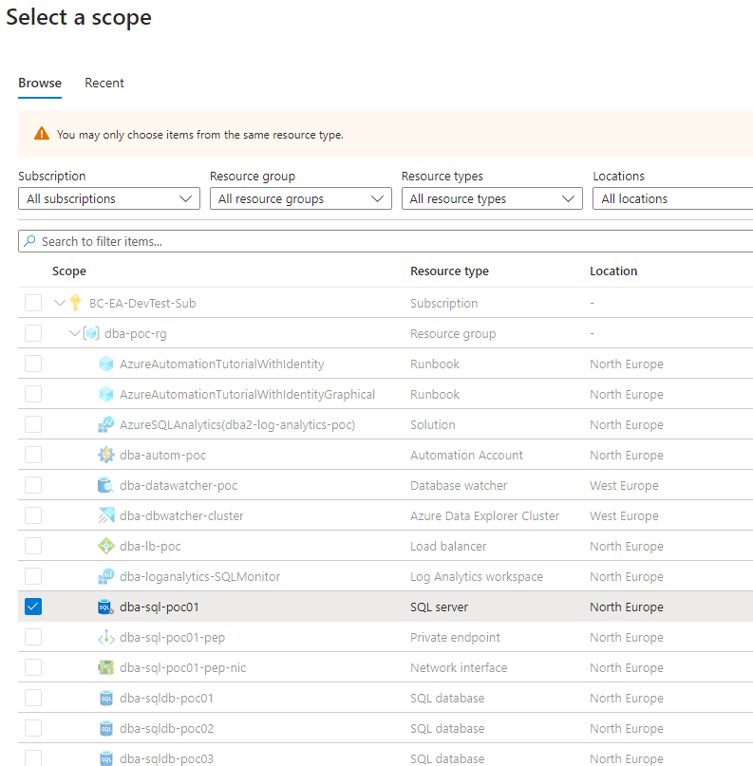
Scope Issues
Scope
We can change the scope just to point at a particular database
BUT you can get different results if you select a database rather than the server
Notes:
Scop
We can change the scope just to point at a particular database
BUT you can get different results if you select a database rather than the server

Slide 25
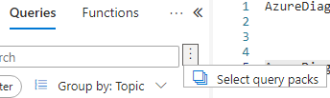
Query Packs
We can save our queries to a Query Pack to share with others
Notes:
We can save our queries
to a Query Pack to share with others

Slide 26
Query Packs
Now we can start to get more useful information out of our database.
Open the Query pack and run a few more complex queries
Notes:
Now we can start to get more useful information out of our database.
Open the Query pack and run a few more complex queries

Slide 27
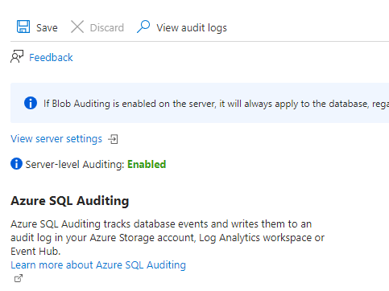
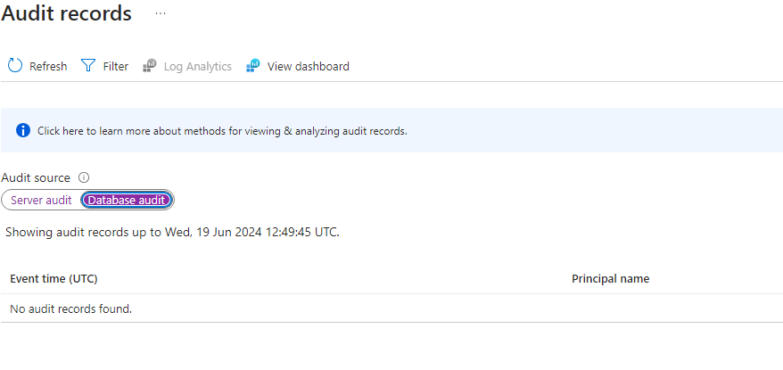
Audit Log Dashboard
Going back to the database auditing screen
Now that we have enabled database Auditing a new option appears at the top “View Audit Logs”
Click on this and you will get a screen that nearly always says “No audit records found”
But more importantly there is a link called “View Dashboard”
Notes:
Audit Log Dashboard
Going back to the database auditing screen
Now that we have enabled database Auditing a new option appears at the top “View Audit Logs”
Click on this and you will get a screen that nearly always says “No audit records found”
But more importantly there is a link called “View Dashboard”

Slide 28
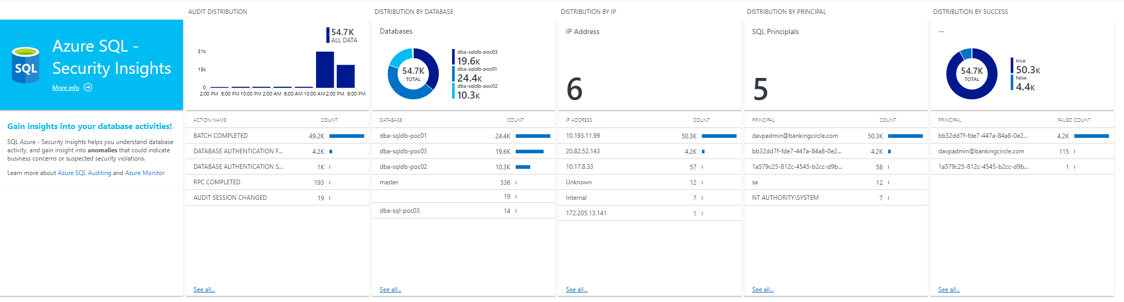
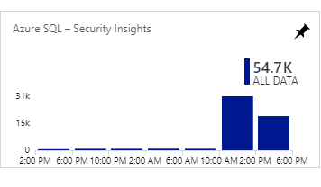
Azure SQL Security Insights
The new screen will show Azure SQL Security Insights with a summary bar graph of activity
You now have some nice graphs of activity on your screen
Drill down to the query
Notes:
Azure SQL Security Insights
The new screen will show Azure SQL Security Insights with a summary bar graph of activity
Click on the box
Sometimes you have to refresh the screen several times before the data will appear
You now have some nice graphs of activity on your screen
You click on any of the graphs to get the query that creates it and use that as a basis to get more detailed data.
See next screen
“Workbooks will replace View Designer”
Workbooks are the new way to create screens like these.
But these screens came ready built with drill downs.
I have yet to find any View Designer screens that match this. Trying to build similar screens in View Designer is a lot of work and I’ve yet to make anything even close

Slide 29
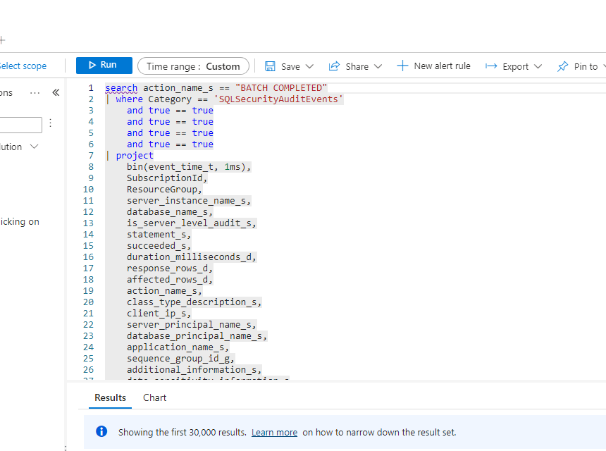
Extract the Query

Slide 30
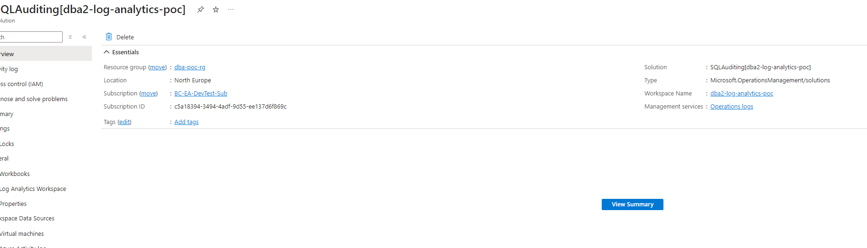
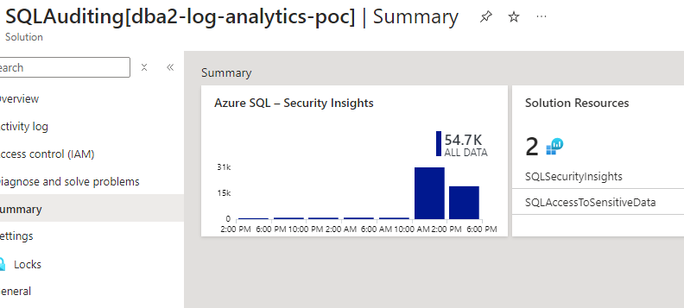
Solutions
What we have created by enabling database auditing is something called a solution. In this case SQLAuditing
You can find it in the resource list for the resource group
Notes:
Solutions
What we have created by enabling database auditing is something called a solution. In this case SQLAuditing
You can find it in the resource list for the resource group

Slide 31
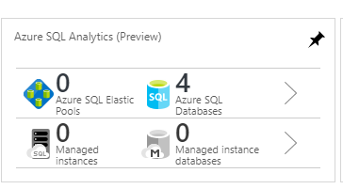
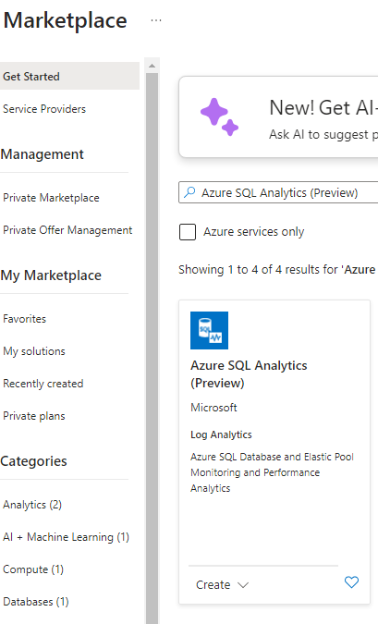
Azure SQL Analytics (Preview)
We can also add another solution from the market place
Select Market Place
search for "azure sql analytics (preview)“
Once installed it create a new solution in your resource group called AzureSQLAnalytics.
And another option on the Dashboard
Which gives us graphs of activity
This requires the extra options in the diagnostics for its data
Notes:
We can also add another solution from the market place
Select Market Place
search for "azure sql analytics (preview)“
Once installed it create a new solution in your resource group.
And another option on the Dashboard
Which gives us graphs of activity
This requires the extra options in the diagnostics

Slide 32
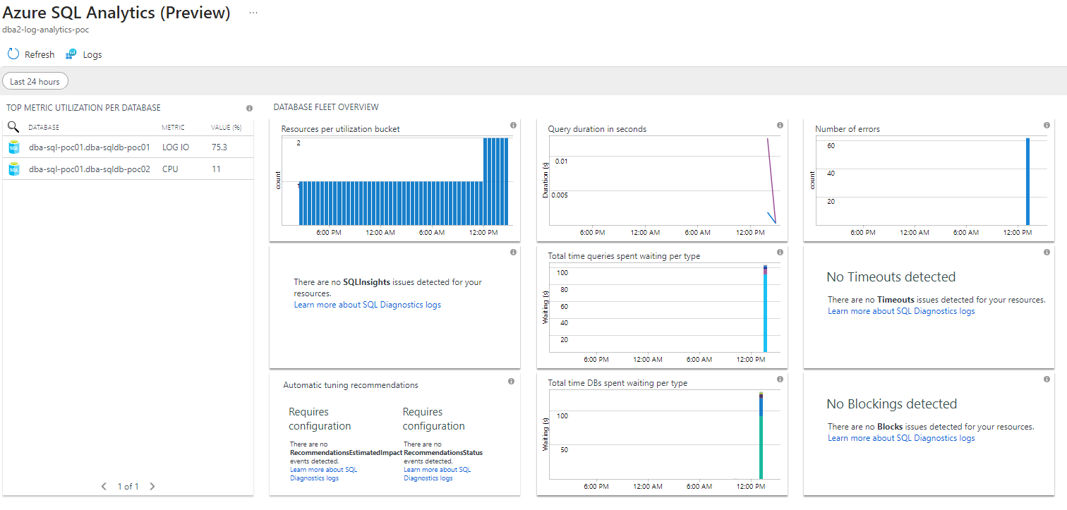
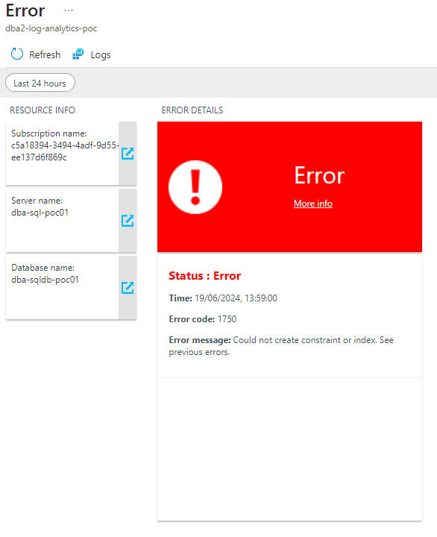
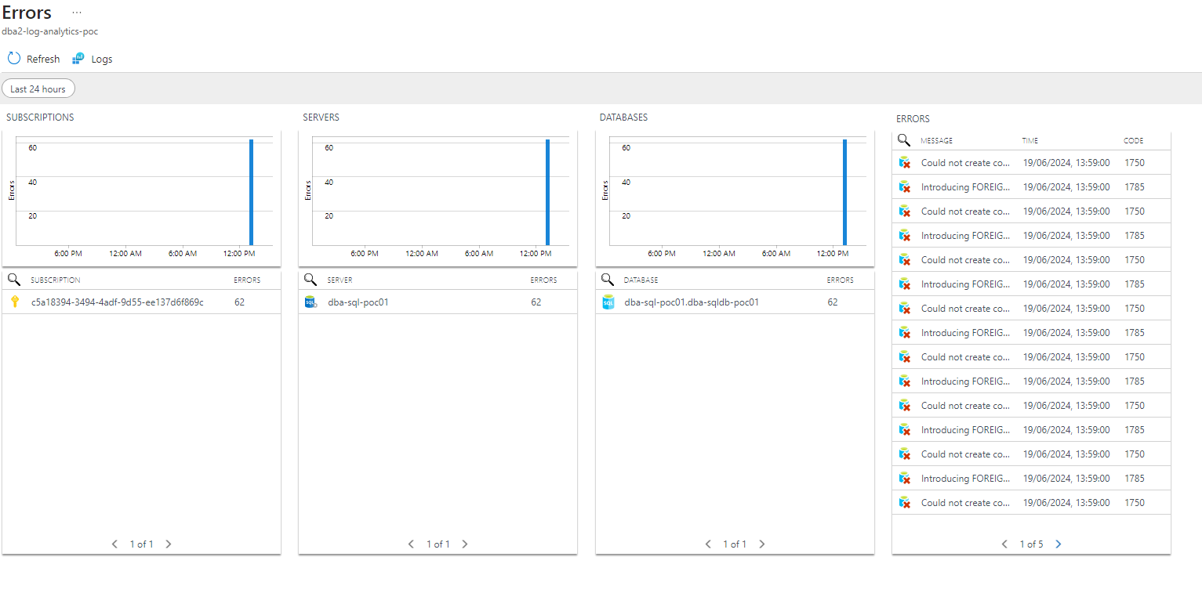
Here we get more graphs of useful information
Again we can drill down to more detail. In this case more graphs
Notes:
Here we get more graphs of useful information
Again we can drill down to more detail. In this case more graphs

Slide 33
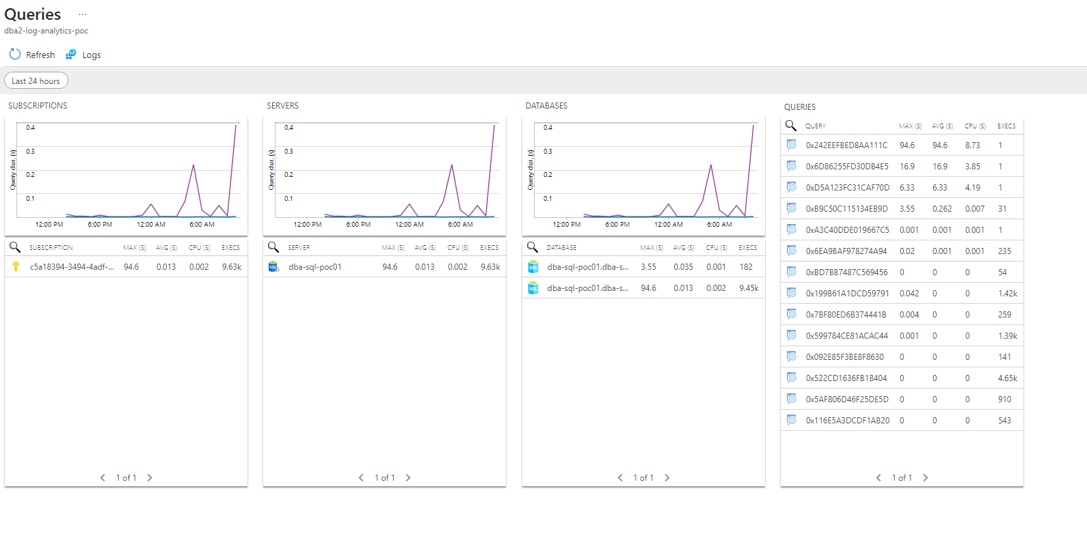
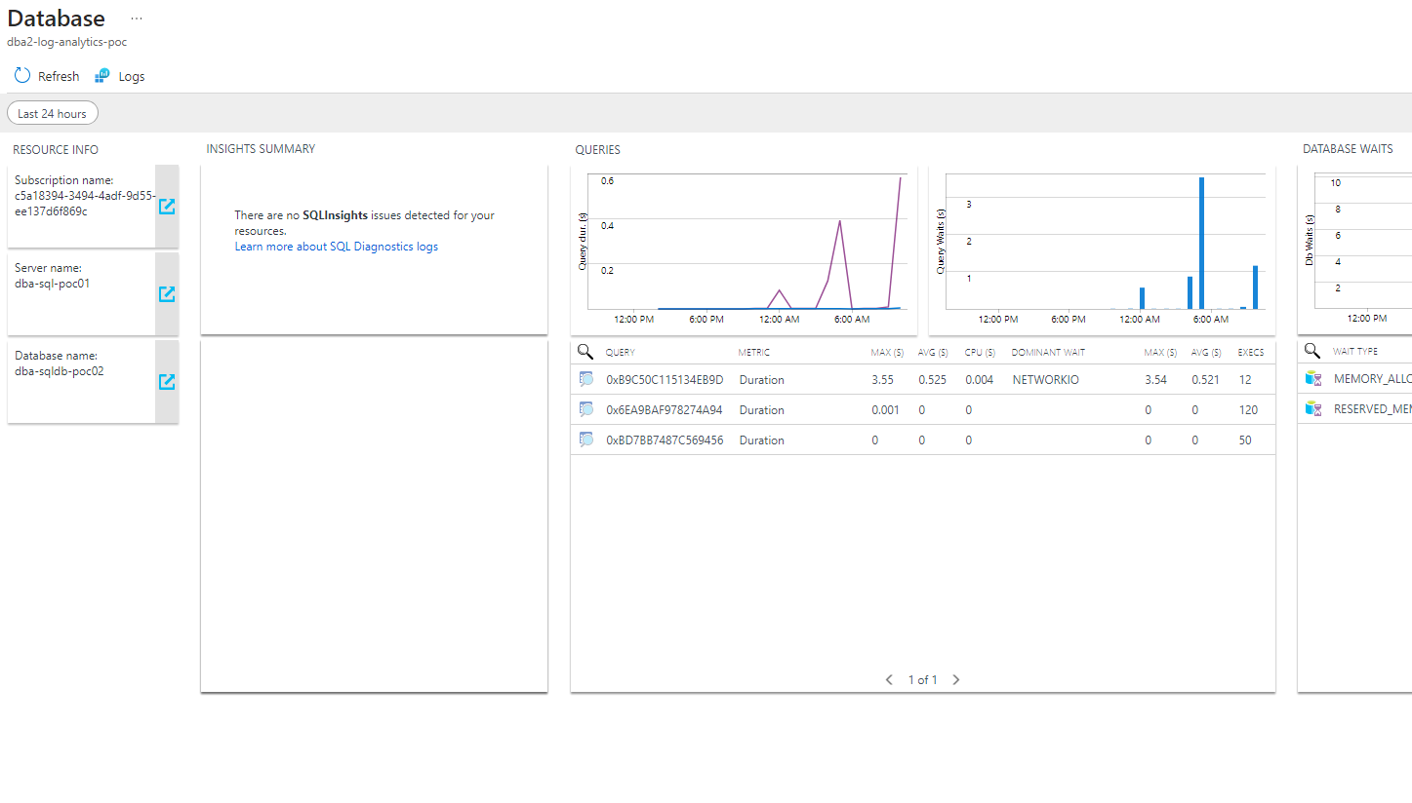
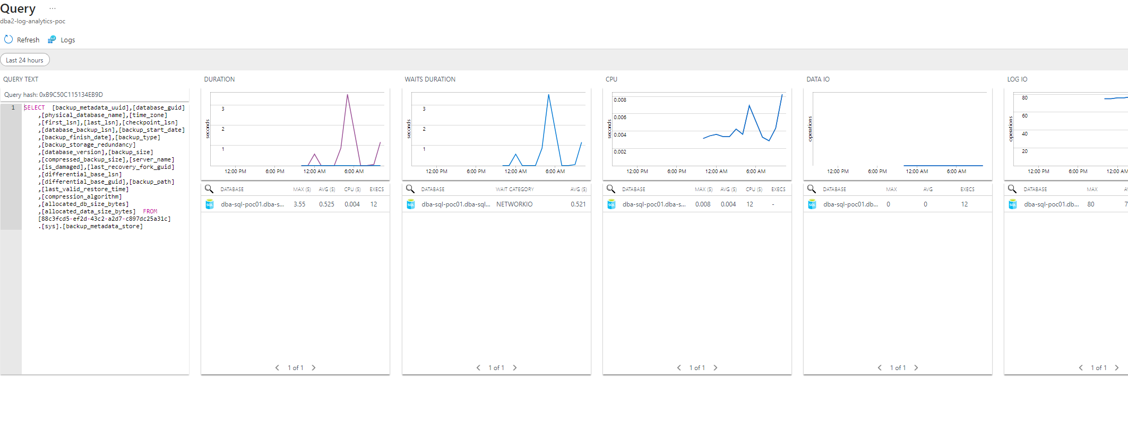
Analytics Drill Down
Notes:
You can drill down to get even more detail

Slide 34
Analytics Summary
In Summary
This has been in preview for at least 4 years and due to be replaced / dropped, maybe
Not seen any other Solutions available in the market place
or improvements to the View Designer
Who knows what will happen
but I think this is pretty useful
Notes:
In Summary
This is all in preview and due to be replaced / dropped
Not seen any other Solutions or improvements to the View Designer
Who knows what will happen but I think this is pretty useful

Slide 35
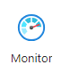
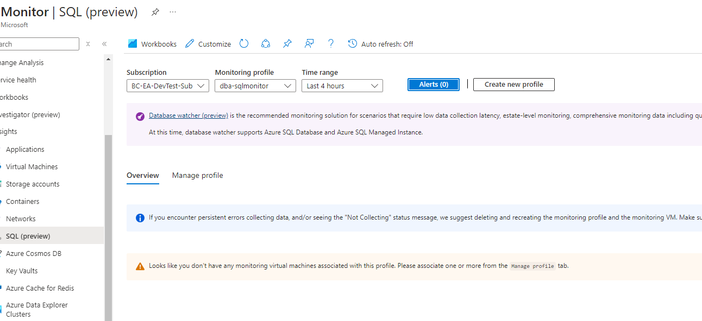
Azure Monitor
The replacement for what we’ve just looked at should be in Azure Monitor
And SQL (Preview)
Replacing a preview feature with another preview feature !
But SQL (Preview) disappeared end of last year
look at the purple text – Database Watcher will replace this preview option. - That is in preview as well !
We’ll see.
Notes:
Azure Monitor
The replacement for what we’ve just looked at is Azure Monitor
And SQL Preview
Replacing a preview feature with another preview feature !
But look at the purple text – Database Watcher will replace this preview option. We’ll see.

Slide 36
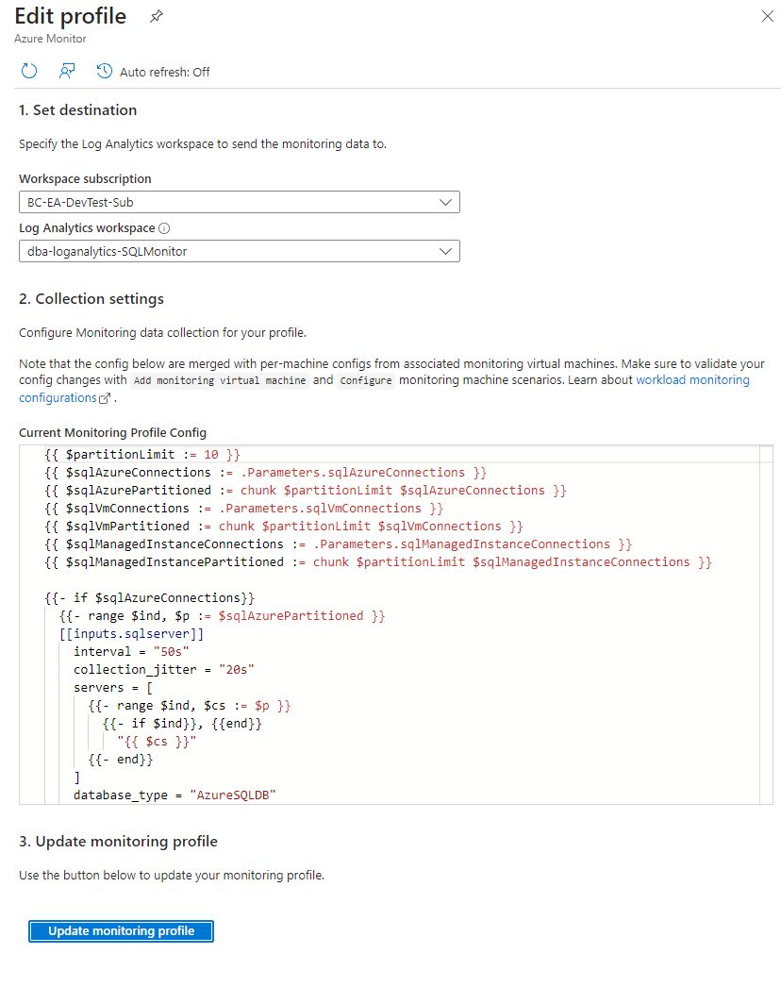
Monitor | SQL (preview)
Setting this up is not straight forward
First create a profile and point this
to a log analytics workspace.
Notes:
Monitor | SQL (preview)
Setting this up is not straight forward
First create a profile and point this to a log analytics workspace.
In our case I’ve created a new workspace just to see the difference

Slide 37
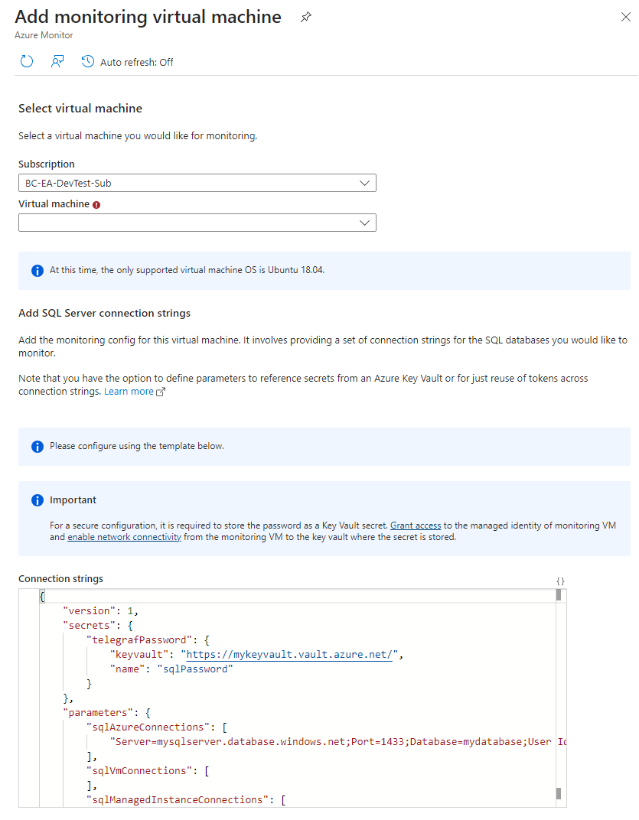
Monitor | SQL (preview)
Then connect to a monitoring virtual machine
Which must be running Ubunto 18.04 because it is using telegraph to collect the data. (18.04 is now out of date) (So more expensive than the previous)
Since this is Linux you can’t use managed identity but a SQL login on each server / database you want to monitor.
You must edit the connection string to the sql database,
the password can be stored in a key vault
Notes:
Monitor | SQL (preview)
Then connect to the monitoring virtual machine
Which must be running Ubunto 18.04 because it is using telegraph to collect the data
Since this is Linux you can’t use managed identity but a SQL login on each server / database you want to monitor.
You must edit the connection string to the sql database, the password can be stored in a key vault

Slide 38
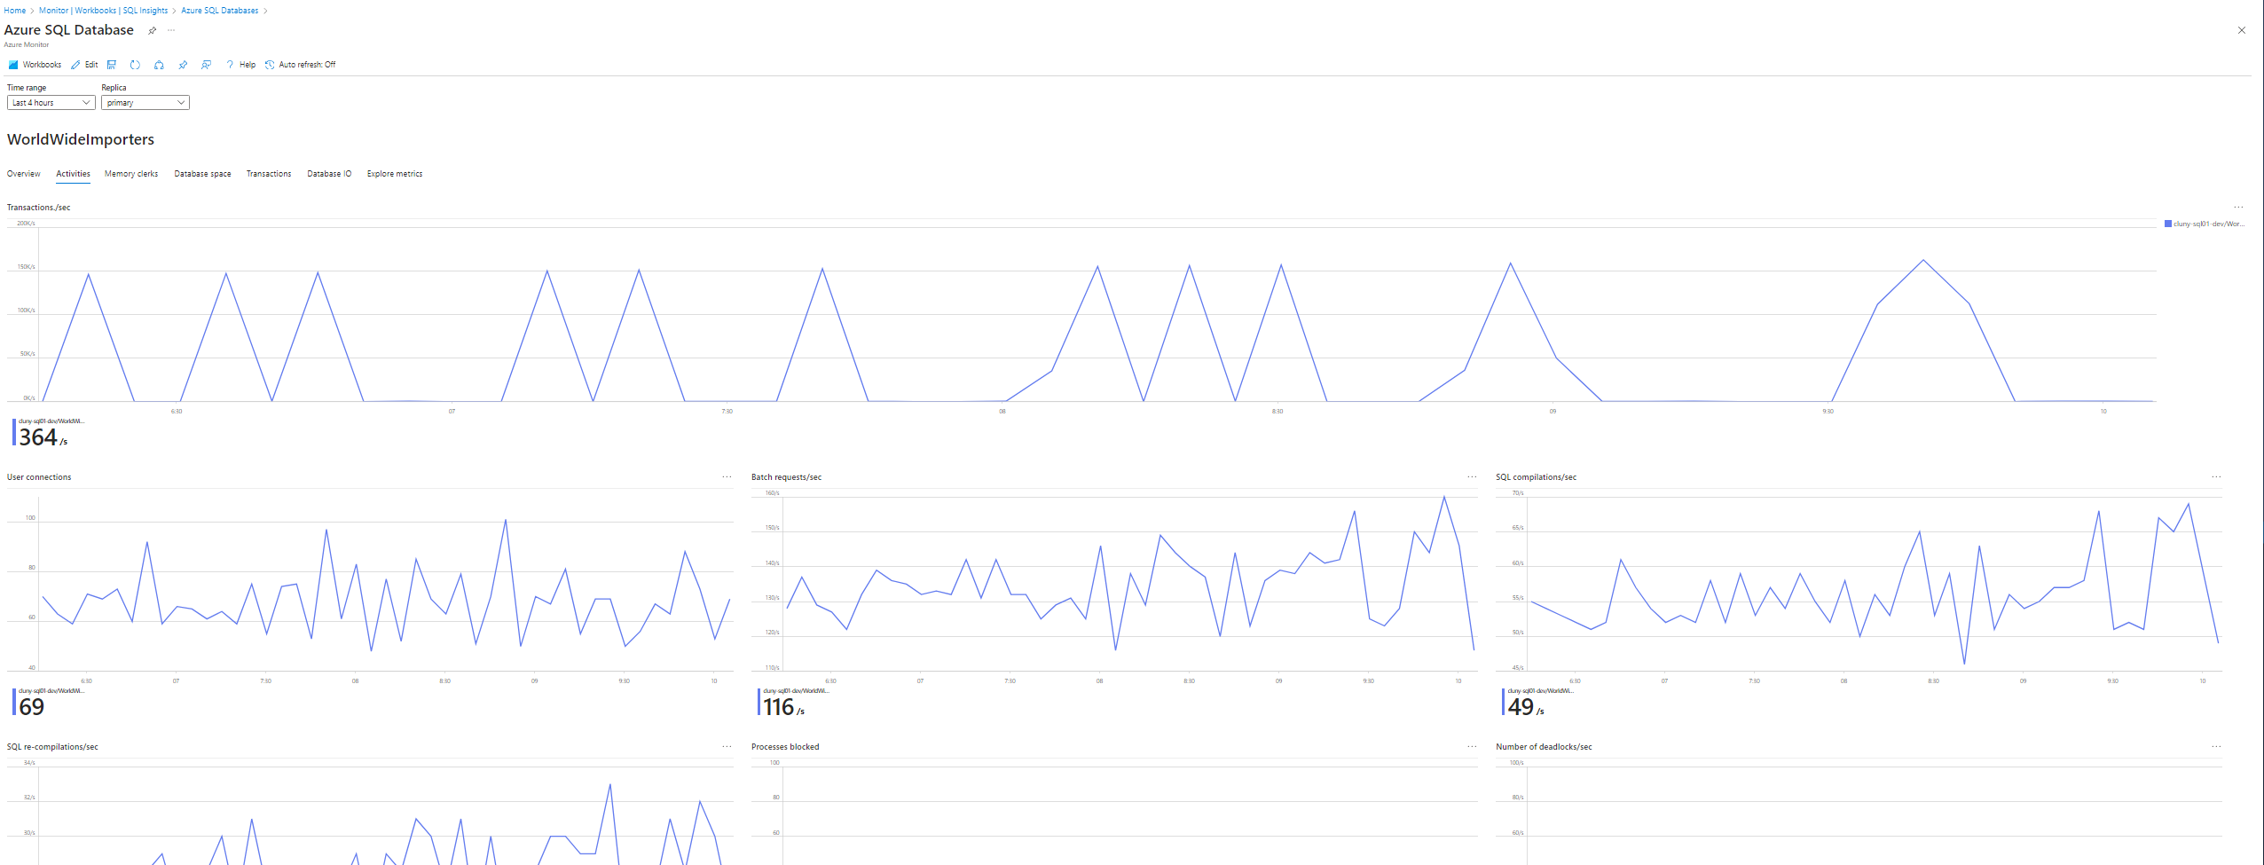
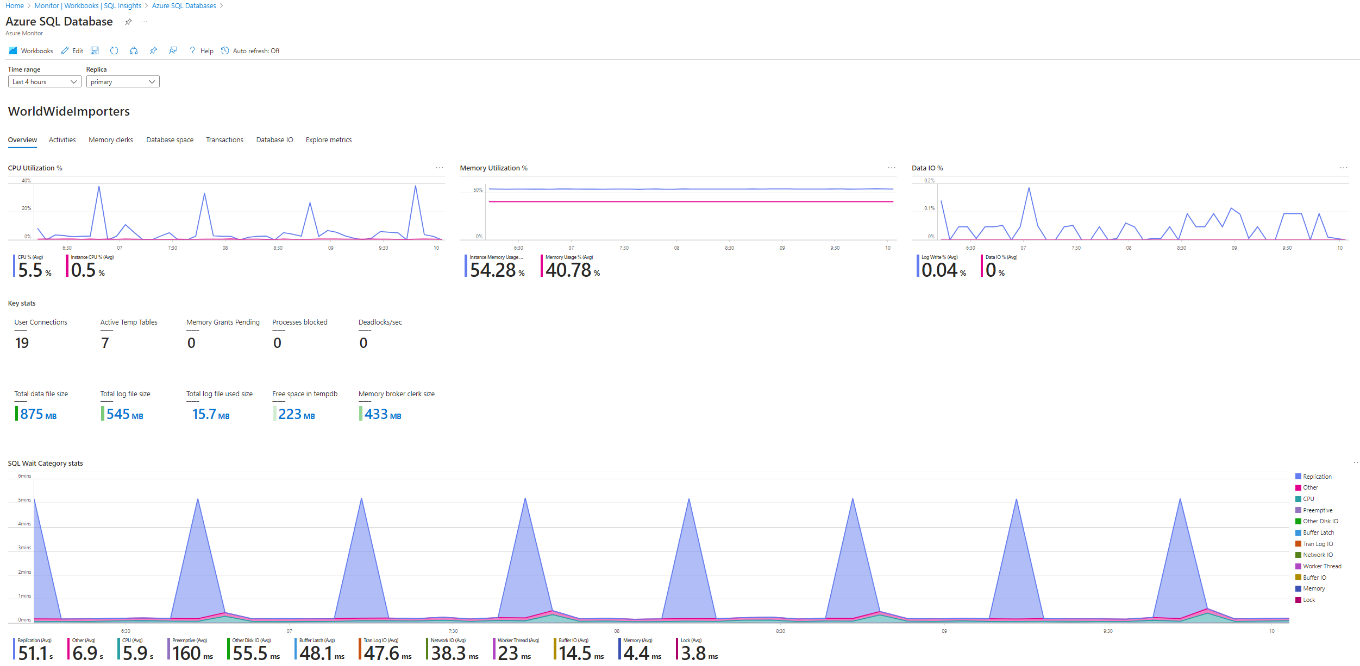
Monitor | SQL (preview)
Notes:
Monitor
Once configured and collecting data then a whole series of new screens full of graphs becomes available.
Is this better than the previous? Yes and no
There is no drill down that I can see to get to the raw data
This is an example of a Workbook.
Workbooks, once you get the hang of them are quite easy to edit and change but there are a lack of examples for SQL from Microsoft. In fact just this one

Slide 39
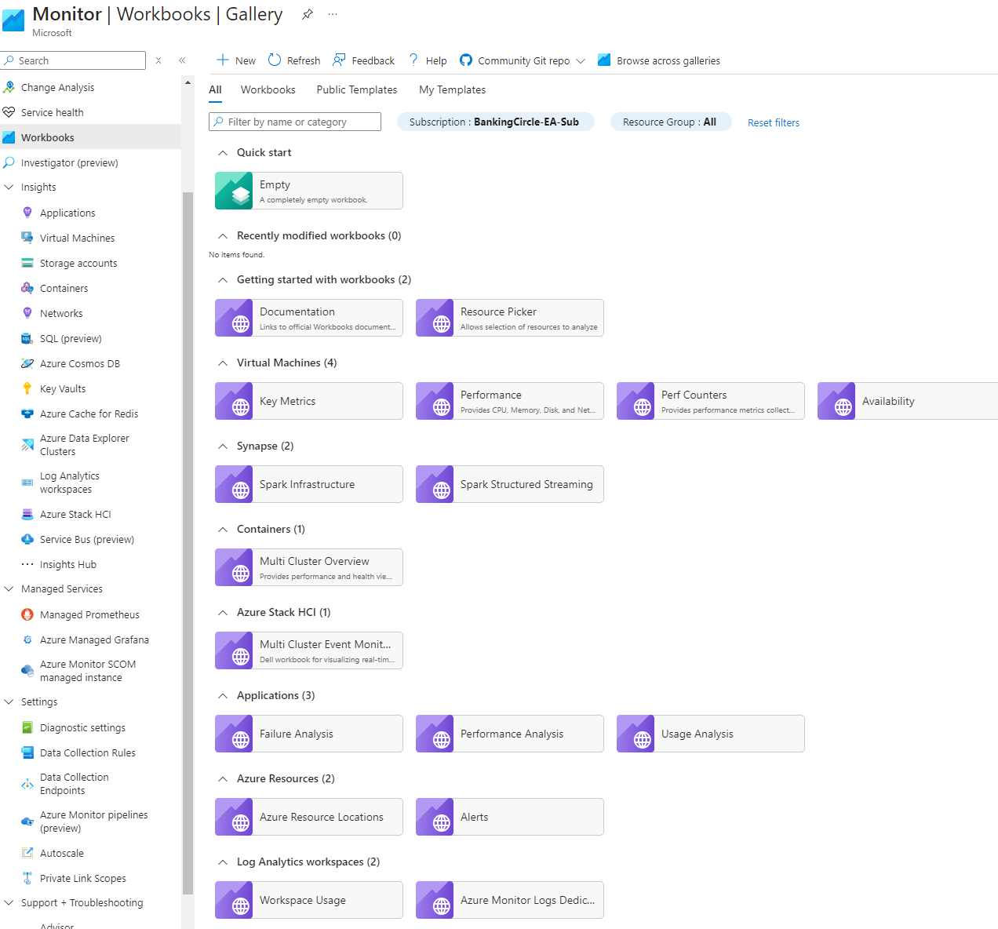
Workbooks
Workbooks are part of Monitor but don’t actually require the SQL monitor logs
You can create workbooks that run queries against your existing log analytics or even the metrics we looked at right at the beginning
Notes:
Workbooks
Workbooks are part of Monitor but don’t actually require the SQL monitor logs
You can create workbooks that run queries against your existing log analytics or even the metrics we looked at right at the beginning
Once you’ve created your workbook you can add them to dashboards

Slide 40
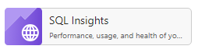
Workbooks
There is one template for SQL called “SQL Insights” This is the one that we have already seen that is automatically added to the SQL (Preview) screen
It only works with a SQL monitoring profile but you can create workbooks that read data from our original analytics workspace.
There aren’t many examples online
I found this one on github
https://github.com/scautomation/Azure-Sql-Insights-Workbook

Slide 41
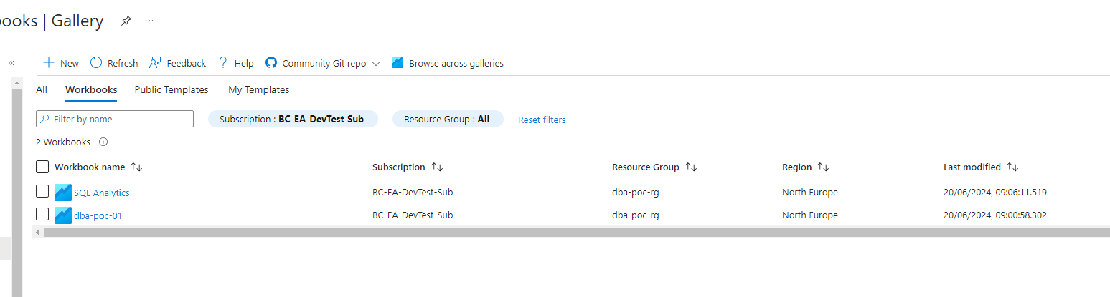
Workbooks
We can see all of the available workbooks from the gallery.
They also appear in your resource group as “Azure Workbook” with a GUID as a name
Notes:
Workbooks
They can appear in different locations depending on where you create them

Slide 42
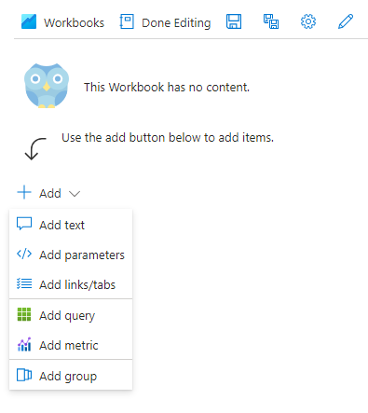
Creating a Workbook
Click Add
On the screen you can add content
Notes:
AzureDiagnostics
| where Category == 'SQLSecurityAuditEvents'
| project event_time_t, statement_s, succeeded_s, affected_rows_d, server_principal_name_s, client_ip_s, application_name_s, additional_information_s, data_sensitivity_information_s
| order by event_time_t desc
| take 100

Slide 43
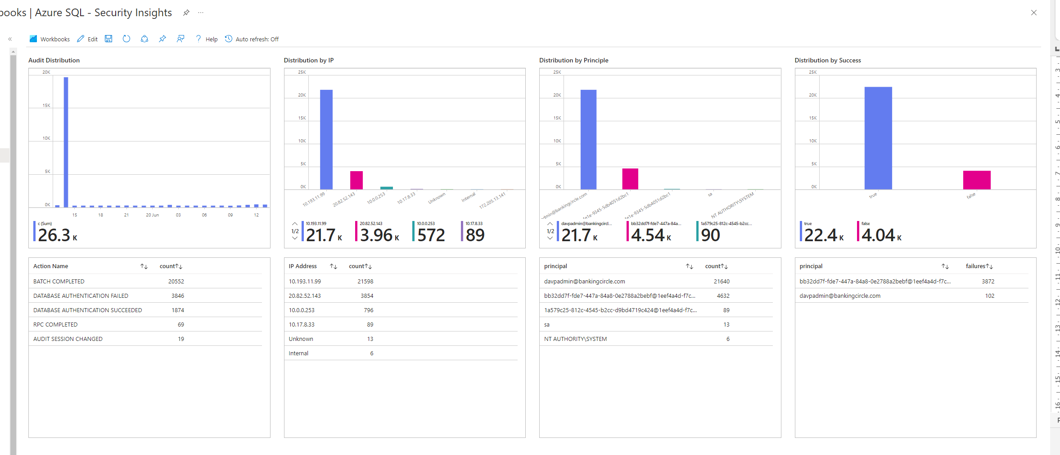
Creating a Workbook
You can use KQL queries from the Insights to reproduce a similar set of graphs

Slide 44
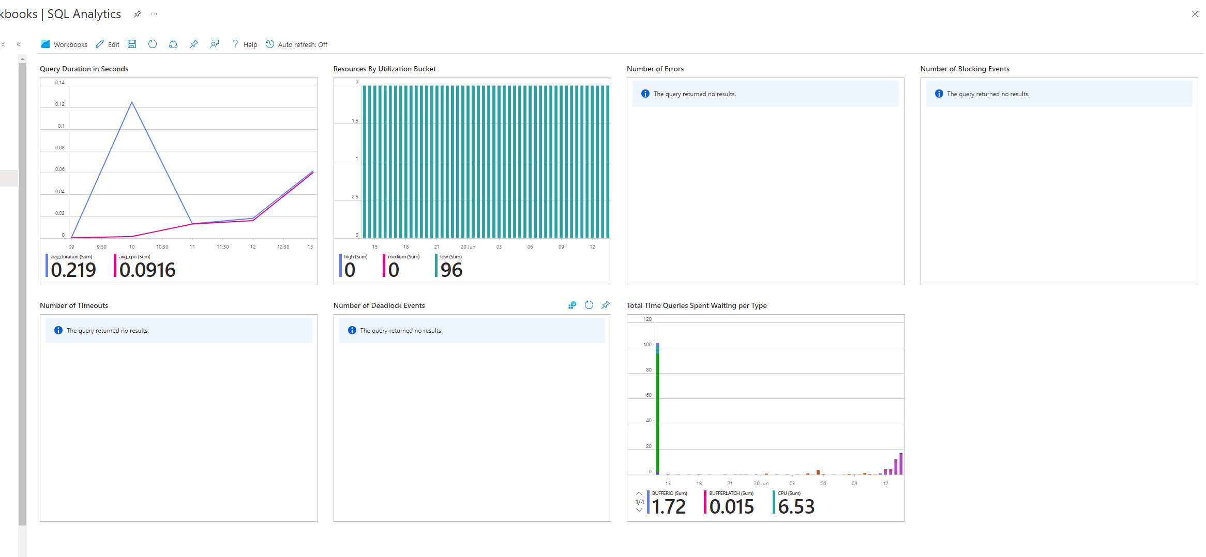
Creating a Workbooks
You can use KQL queries from the Insights to reproduce a similar set of graphs

Slide 45
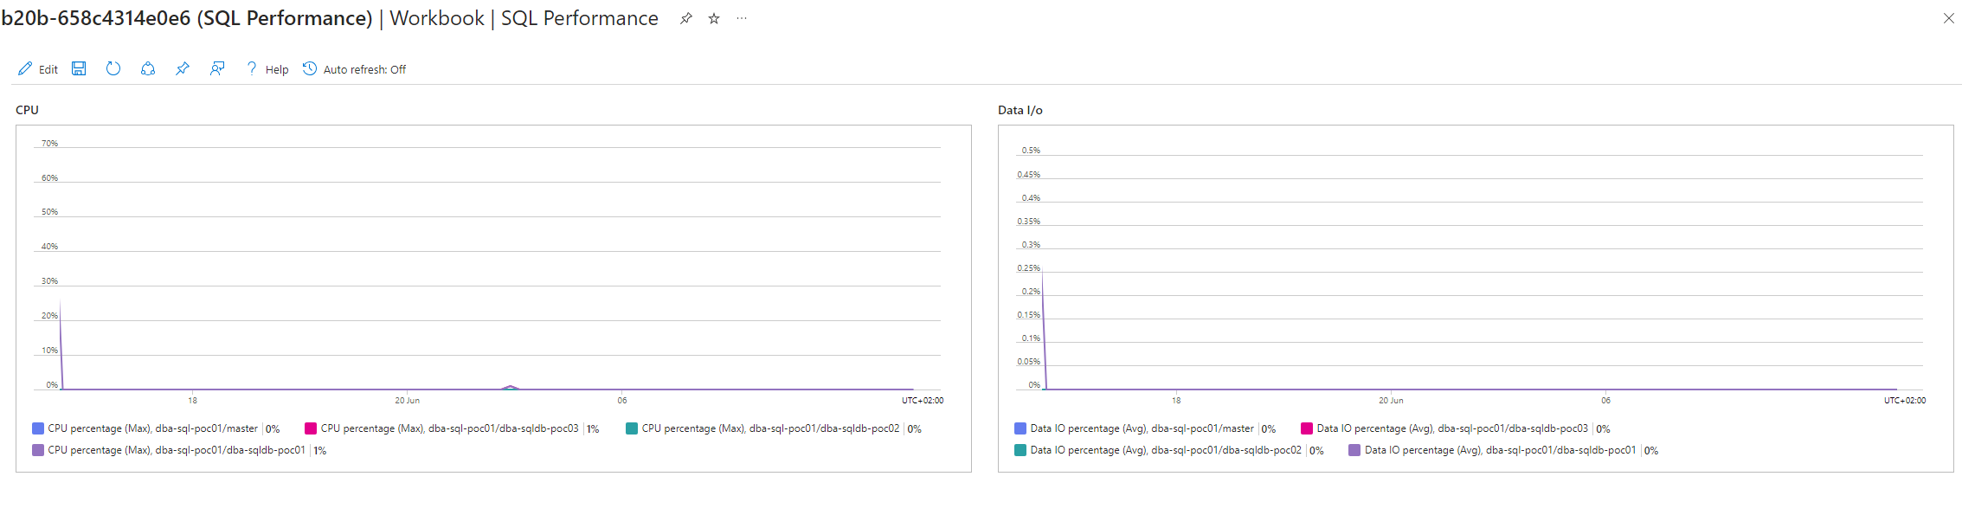
Creating a Workbooks
We can also use the standard metrics, just like in the dashboards

Slide 46
Workbook Location
A workbook belongs to the place that you created it from.
This does make it difficult to catalogue and find them
Doesn't seem possible to change the “owner” without downloading the json, editing and creating a new workbook using the edited json

Slide 47
WorkBooks
Summary
These allow us to create charts and graphs using data from a log analytics workspace.
They provide more options than the original dashboards
Notes:
AzureDiagnostics
| where Category == "QueryStoreWaitStatistics"
| where ResourceId contains "/SERVERS/"
| where ResourceId contains "/DATABASES/"
| project
Resource = strcat(extract(".+/SERVERS/([^/]+)/.+", 1, ResourceId), ".", extract(".+/DATABASES/(.+)", 1, ResourceId)).tolower(),
TimeGenerated,
total_query_wait_time_ms_d,
wait_category_s
| summarize total_wait_time = sum(total_query_wait_time_ms_d) / 1000
by wait_category_s, bin(TimeGenerated, 30m)
| top 1000 by total_wait_time desc
| evaluate pivot(wait_category_s, sum(total_wait_time))
| render barchart

Slide 48


Database watcher (preview)
Database Watcher is supposed to be the product to use but it is still limited. This is also Preview (in some places)
Looks like Microsoft’s attempt to compete with 3rd party monitoring tools but it lacks many features. Alerting has only recently been added and is a cost option
I’ve tried several times to get it to work, it seems very hit and miss if it will start displaying data or not
Notes:
Database Watcher
Database Watcher is supposed to be the product to use but it is still limited.
It now has an alert option but it is a cost option
The documentation states that it is not a replacement for insights
I’ve tried several times to get it to work and failed each time.
I can see it querying the sql database but the data never makes it to the cluster where the data is stored

Slide 49

Azure Data Explorer cluster
Notes:
Just no data ever arrives

Slide 50

With fabric Kusto data store

Slide 51

Example

Slide 52
Summary
We have three different ways of monitoring Azure SQL,
SQL Analytics and Diagnostics (in preview)
Workbooks (missing SQL)
Database Watcher (in preview)
There are plenty third party tools to monitor your database.
Woodler – here today
Plus lots of others

Slide 53

E-MAIL
david@clunyweb.co.uk
LINKEDIN
www.linkedin.com/in/davidpostlethwaite

